Slide 1


Olist Store Analysis

Slide 2
Mentor Name
Dipiti
Group Members
Mr. Mohammad Dilawar Ali
Mr. Munnanuri shiva kumar
MS.Dharanikota Ramya Sree
MS. sowjanya kuppili
Mr. Rohit Naidu
Mr. Arun Konar

Slide 3
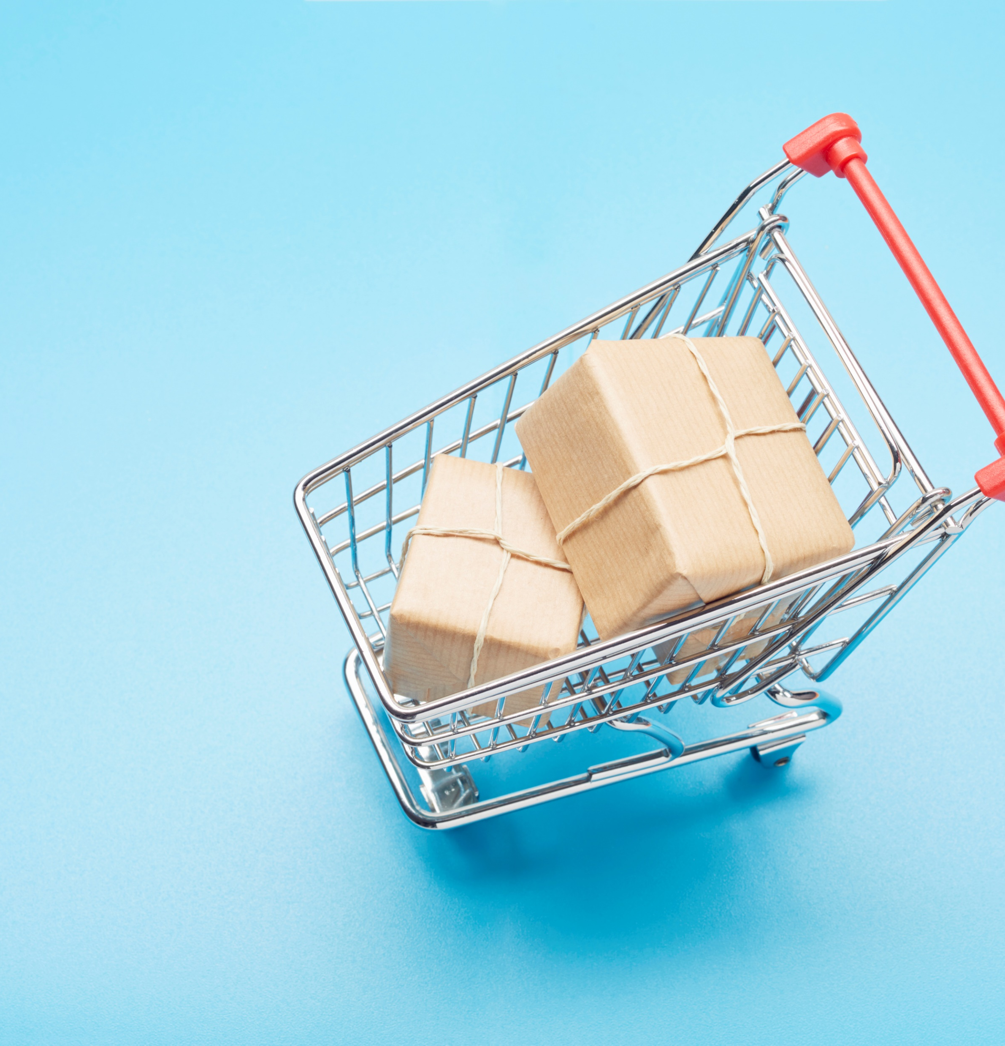


DATASET
Domain
E-commerce
Project Name
Olist Store Analysis
Dataset Type
CSV Data

Slide 4
1
KPI’s
Weekday Vs Weekend (order_purchase_timestamp) Payment Statistics
2
Number of Orders with review score 5 and payment type as credit card.
3
Average number of days taken for order_delivered_customer_date for pet_shop
4
Average price and payment values from customers of sao paulo city
5
Relationship between shipping days (order_delivered_customer_date - order_purchase_timestamp) Vs review scores.

Slide 5

INTRODUCTION
Olist Data is a comprehensive Brazilian E-Commerce Public Dataset. It serves as a marketplace enabling sellers to showcase their products to a wider audience, alongside tools for effective store management, order tracking, and customer support. As Brazil's premier department store in the marketplace domain, Olist simplifies the process for small businesses across the country, connecting them to various channels seamlessly through a single contract. By leveraging Olist's platform, merchants can showcase their products on the Olist Store and utilize Olist's logistics partners for efficient delivery directly to customers. The company's focus lies in optimizing product structuring and delivering top-notch service to both tenants and end consumers

Slide 6

DATA MODEL There are multiple datasets associated with the Olist store, and each dataset is connected through a common column .

Slide 7

KPI-1
Weekday Vs Weekend
(order purchase timestamp) Payment Statistics

Slide 8
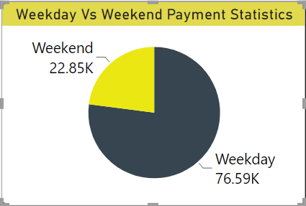
Weekday Vs Weekend
Analysis:
Payment Distribution : On weekdays, the majority of payments were made during business hours, while on weekends, payments were more evenly spread throughout the day.
Transaction Volume : The analysis revealed a higher transaction volume on weekdays, with a significant drop observed during weekends.
Interestingly, the average payment amount on weekdays was found to be higher compared to weekends, indicating potentially different spending behaviors.
The number of orders received on weekdays is 76k and on weekends 22k.
SUGESSTION :
To increase the weekend sales we can release any special offers on the weekends or Tuesdays. Which helps to generate more revenue.

Slide 9
KPI-2
Number of Orders with review score 5 and payment type as credit card

Slide 10
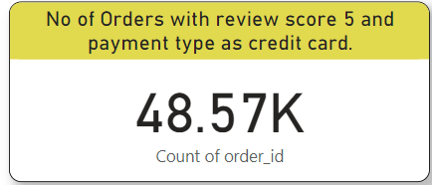
Number of Orders with review score 5 and payment type as credit card
Overview:
We had received 48,570 with a review score of 5 and payment type as credit card.
A substantial number of customers, approximately 74%,rated their orders with a perfect score of 5,reflecting exceptional satisfaction with the products or services received.
Credit card is listed topmost used payment method followed by baleto ,voucher and debit card.
More than 70% of products were purchased by Credit Card. However, payment using Boleto has slightly increased by 7%.
Suggestions:
Businesses can leverage this insight by emphasizing the benefits of credit card payments ,such as security and convenience, to further enhance customer satisfaction and encourage positive reviews.

Slide 11
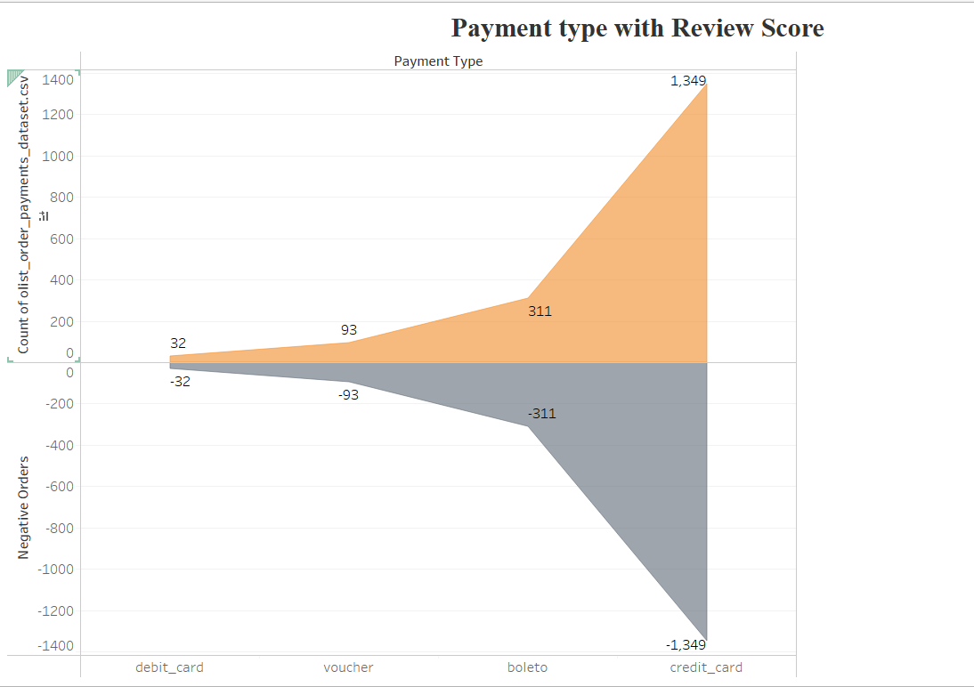
Suggestions:
Businesses can leverage this insight by emphasizing the benefits of credit card payments ,such as security and convenience,to further enhance customer satisfaction and encourage positive reviews.

Slide 12
KPI-3
Average number of days taken for
order delivered customer date for petshop

Slide 13
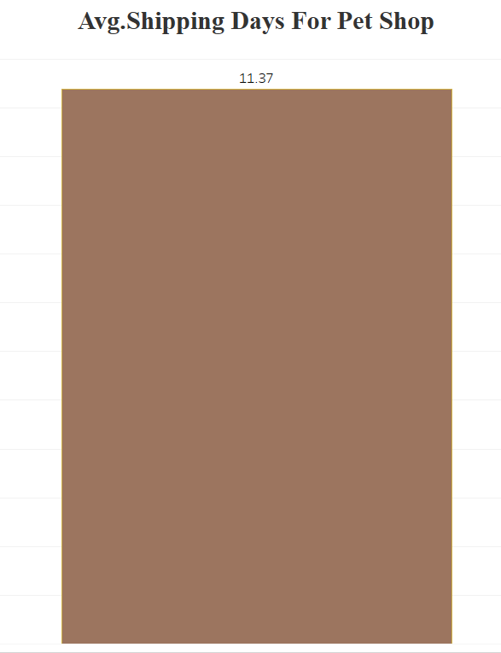
Average number of days taken to deliver order for pet_shop
Overview:
Average number of days taken for the Delivery for pet shop is 11 days.
The pet shop has experienced a significant increase in orders, with a growth rate of 40% over the past 2 years.
The pet shop has received great review scores from customers indicating high levels of satisfaction with their purchases and overall experience.
SUGGESTIONS:
To accommodate the increased order volume while maintaining quality and timely deliveries ,the pet shop needs to focus on enhancing its operational efficiency.
In operational efficiency we have to implement an automated inventory management system, optimizing order processing workflows, and establishing strong partnerships with reliable shipping carriers can help the pet shop meet the growing demands efficiently.

Slide 14
KPI-4
Average price and payment values from customers of Sao Paulo city

Slide 15
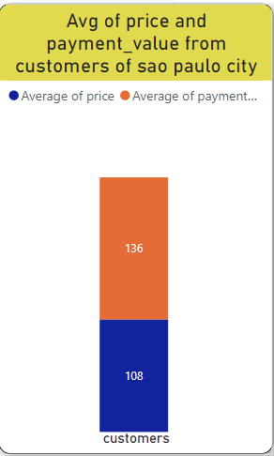
Average price and payment values from customers of saopaulo city
Overview :
Sao Paulo city is the most populous city in the Brazil and Consider as global city with impressive statistics.
Sao Paulo city accounts for approximately 16% of the total orders received by the business, while generating 14% of the total revenue.
Average delivery time for orders from customers in Sao Paulo is 8 days which means this city has delivering the packages very early.

Slide 16
KPI-5
Relationship between shipping days (order_delivered_customer_date - order_purchase_timestamp) Vs review scores.

Slide 17
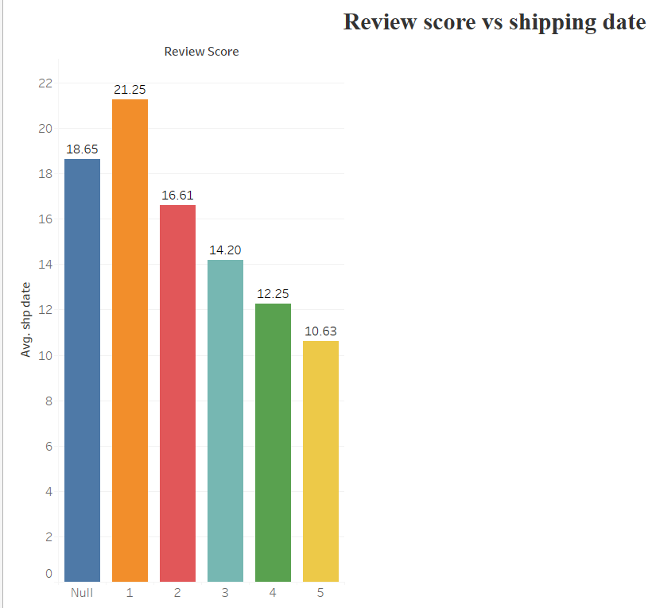
Relationship between shipping days Vs review scores
Overview:
We get positive/high ratings when delivery time is less and negative feedback from the customers when it takes long to deliver the product.
Lesser the delivery days – the higher the positive reviews.
However we can see easily understand the relation between shipping days vs review score by seeing the image.
Suggestions :
Prioritize delivery speed : Aim to further reduce shipping days across all review scores, emphasizing prompt and reliable deliveries.
Customer feedback loop :Establish a feedback mechanism to gather insights directly from customers regarding their shipping experiences, enabling the business to address concerns promptly and make informed decisions for improvement.

Slide 18

SOME OTHER INSIGHTS

Slide 19
TOP 5 VS BOTTOM 5 CUSTOMER STATE
TOP 5
BOTTOM 5
CUSTOMER STATE | TOTAL ORDERS
SP | 47449
RJ | 14579
MG | 13129
RS | 6235
PR | 5740
CUSTOMER STATE | TOTAL ORDERS
RO | 278
AM | 165
AC | 92
AP | 82
RR | 52
The 77% of orders are placed from top 5 states whereas bottom 5 scores only 0.5%

Slide 20
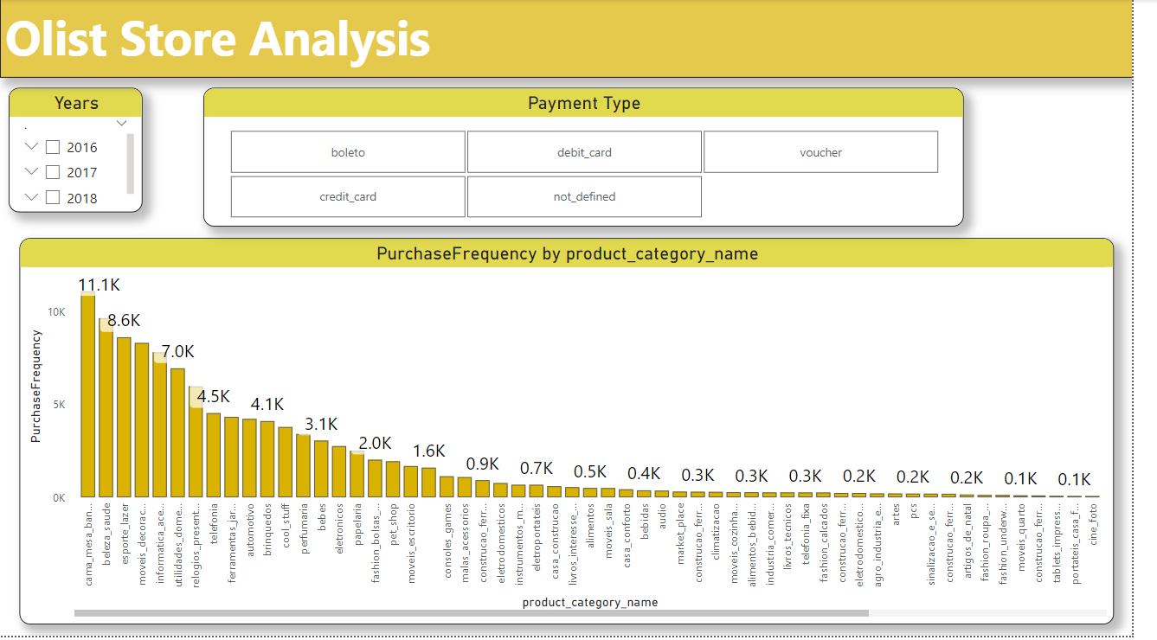
Purchase Frequency by product category name
This Power BI report provides a comprehensive analysis of Olist Store's product sales, focusing on product categories, purchase frequency, and payment methods. The product categories range from bedroom and kitchen items to electronics, with telephony and electronics showing the highest purchase frequency. The report breaks down the purchase frequency by product category, years (2016, 2017, and 2018), and payment types (credit card, boleto, debit card, voucher). Notably, most purchases were made using credit cards. The report enables Olist Store to gain insights into customer purchasing behavior and identify trends, facilitating informed business decisions.

Slide 21

Conclusion
The analysis also focuses on the product categories with respect to the price and the review score of the customer. So, if the company focuses on the product’s pricing strategy and makes product improvements on the basis of consumer opinion, the company can make better revenue and can increase the range of products under each category.
The organization needs to purposely address the purchaser's survey and continue to adjust and change the item range. Future work in this space might incorporate recognizing how connections revealed in this investigation might be applied to further develop income inside comparative internet business organizations in Brazil
SUGGESTIONS :
Prioritize efficient shipping - Ensure timely and reliable deliveries
Continuous process improvement - Regularly evaluate and enhance operational efficiency
Customer feedback and insights - Actively listen to customer feedback , address concerns promptly

Slide 22
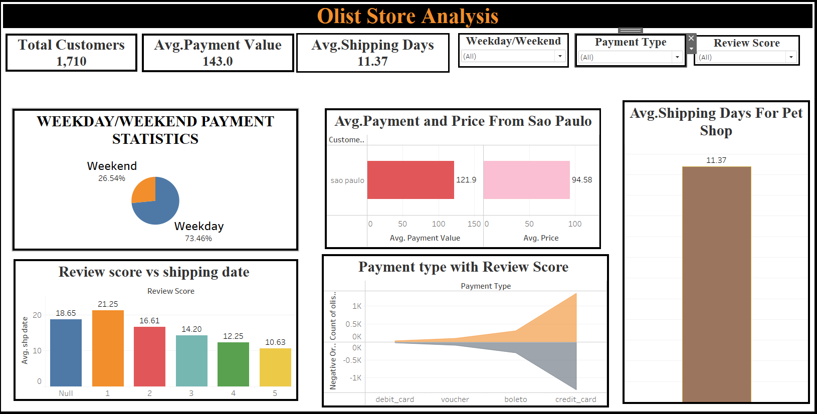
TABLEAU DASHBORD

Slide 23
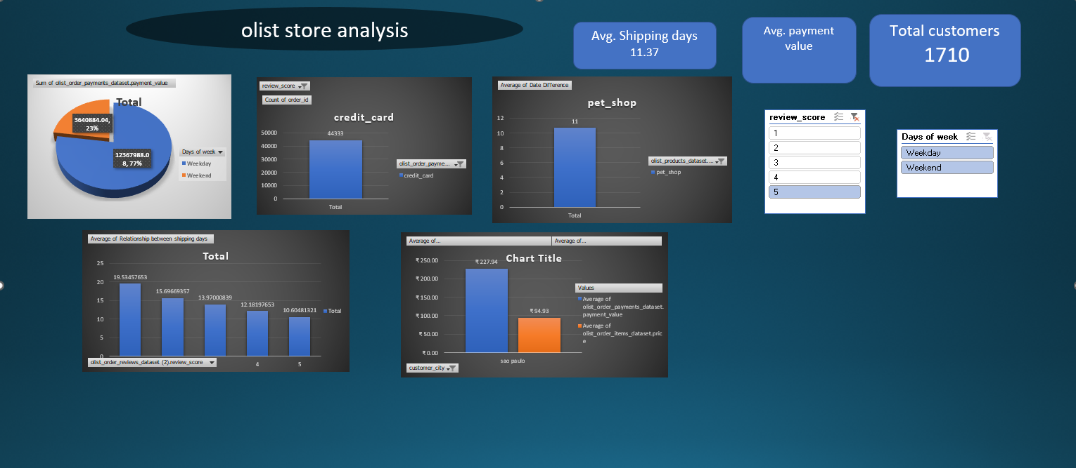
EXCEL DASHBORD

Slide 24
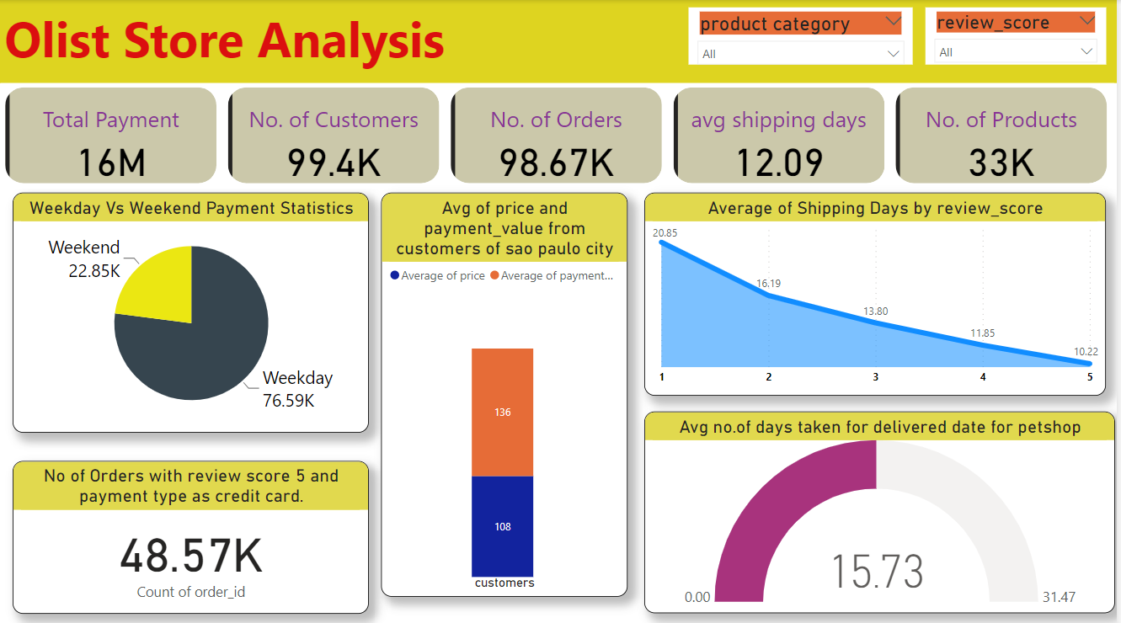
POWER BI DASHBORD

Slide 25

Thank You

